Slide 1
San Jose Earthquakes Historical MLS Data
Due April 12th 2024

Slide 2
Data Description - Background Info
I have 4 datasets, all relating to MLS, (Major League Soccer) which is the first (highest) division of soccer in the United States
The datasets are as followed:
matches - grabs all information about games between 2001 - 2020
209 columns and 7289 rows
all_goalkeepers - grabs statistics on goalkeepers between 1996 - 2020
19 columns & 2006 rows
players - grabs statistics on the rest of the players between 1996 - 2020
28 columns & 15767 rows
mls standings - grabs league standings between the years 2000 - 2022
12 columns and 401 rows
What variable do you want to predict and why?
I actually created a variable called result in the matches dataset where it tells us if a team has won a game, lost a game, or drawn a game with the values 1, 0, and 2 respectively.
With this new variable, I want to predict the result of matches for one specific team, which is the San Jose Earthquakes (only between wins or loses), to see if the Earthquakes are unlucky, lucky, or getting fair results.

Slide 3

Goalkeeper Statistics

Slide 4
Descriptive Statistics - SJ Goalies
My first focus was on Goalkeeper statistics to see what the history at the GK position has been like.
4 statistics that I honed in on was the following:
GAA (Goals Against Average) - how many goals against per game the GK average (ex: 1.5 means GK lets in 1.5 goals per game)
Save Percentage - divides shots saved over total # of shots faced
Clean Sheets - how many times a GK had 0 goal games against
Win Percentage - win percentage of the GK
One last note, I filtered it so it only took into account the regular season as that provided more data and I only chose goalkeepers that have played at least 5 games to give a more accurate representation of the data (some goalkeepers never played a single game so all there stats would be 0 and would mess up the interpretation/analysis)

Slide 5
Goalkeeper Statistics
 | GAA | Sv% | ShO | W%
count | 27 | 27 | 27 | 27
mean | 1.51 | 69.11 | 5.30 | 37.73
mode | 1.12 | 63.60 | 7 | 16.70
Standard Deviation (std) | 0.53 | 6.83 | 2.91 | 16.10
min | 0.60 | 53.20 | 0 | 0
25% | 1.2 | 63.60 | 3 | 24.90
50% (median) | 1.3 | 70.60 | 6 | 38.90
75% | 1.7 | 74.40 | 7 | 52
max | 3.1 | 83.30 | 12 | 62.50
San Jose's goalkeepers boast a high save percentage, the best statistically among their peers.
A save percentage above 50% is considered decent, with 60-70% being good and 70-80% being great.
Despite facing numerous shots, they maintain a solid performance, conceding around 1 goal per game.
The GAA falls within the expected range for a normal goalkeeper.
Achieving a GAA under 1 is rare and typically reserved for top-tier goalkeepers.
The MLS may not attract the world's best players.
However, the team's win percentage and clean sheet (shutout) record are not particularly impressive.
Rounded to nearest hundredth

Slide 6
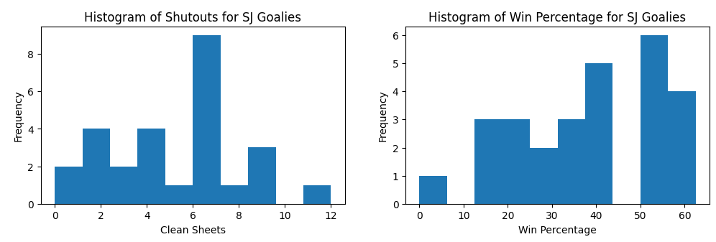
Histogram + More Explanation
Historically, clean sheet records for goalkeepers are notably poor.
Typically, goalkeepers aim for at least 10 clean sheets in a season, or close to it.
The majority of goalkeepers fall within the range of 0-7 clean sheets, with only a few meeting the threshold of being considered decent.
Win percentage is also not particularly impressive, with most goalkeepers having a percentage below 42-43%.
A solid win percentage is around 45%, but considering the decent GAA and save percentage, a higher win percentage might be expected.
Factors beyond the goalkeeper's performance influence these statistics, such as the quality of the defensive backline and the effectiveness of the offensive players in scoring goals.
Coaching also plays a significant role in the team's performance.

Slide 7

Data Visualization - Offensive vs Defensive

Slide 8
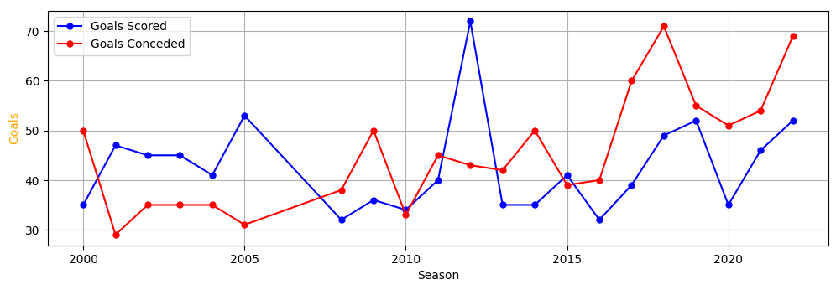
Visualization #1

Slide 9
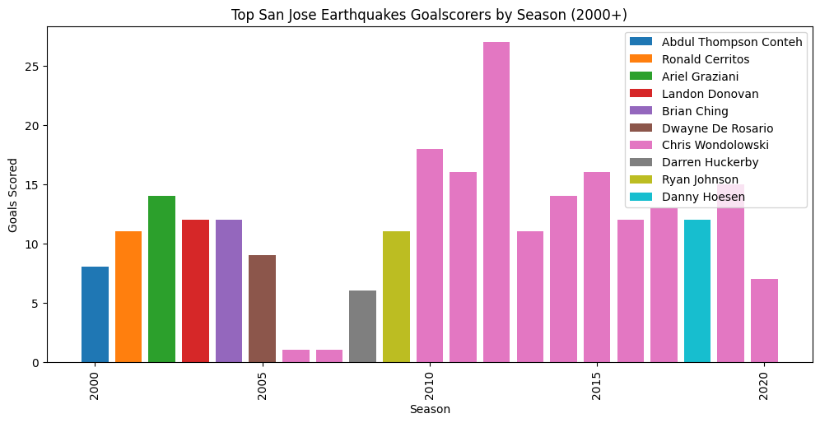
Visualization #2

Slide 10
What does the two visualizations mean in context?
The transition in San Jose Earthquakes' playstyle, notably shifting from a defensive to an offensive focus around 2012 (with the first visual), has a potential association with the rise of prolific goalscorer Chris Wondolowski (in the second visual). This strategic shift may have prioritized building the team around Wondolowski's goal-scoring prowess, potentially at the expense of reinforcing the defensive backline, which made the Earthquakes successful in the earlier years/seasons. Moreover, changes in ownership during this period, marked by reduced investment in the roster, likely exacerbated the team's declining performance.

Slide 11

Machine Learning - Predicting Results for the San Jose Earthquakes

Slide 12
Machine Learning - What Features, Predictor, and Model?
Features (12): home_score, away_score, home_possessionPct, away_possessionPct, home_redCards, away_redCards, home_wonCorners, away_wonCorners, home_saves, away_saves
Predictor variable: result (as described in the background slide)
Model: I will be using Logistic Regression as my model for binary classification

Slide 13
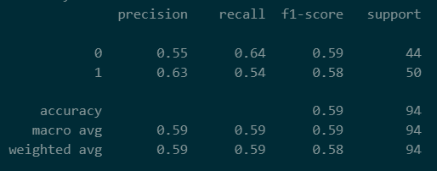
Model Inspection - Did it do poor, fair, or great?
# Split the data into features and target variables
X = san_jose_matches[['home_score', 'away_score', 'home_possessionPct', 'away_possessionPct', 'home_foulsCommitted', 'away_foulsCommitted', 'home_redCards', 'away_redCards', 'home_saves', 'away_saves']]
y_result = san_jose_matches['result']
# Split the data into train and test sets
X_train, X_test, y_train, y_test = train_test_split(X, y_result, test_size=0.2, random_state=42)
model = LogisticRegression()
model.fit(X_train, y_train)
predictions = model.predict(X_test)
# Calculate accuracy
accuracy = accuracy_score(y_test, predictions)
print(classification_report(y_test, predictions))
Overall, I would like to think my model is fair or at least okay with trying to predict the result of matches for SJ. If we just take raw probability into account, that’s a 50% to guess the result correctly while my model increases that chance to at least 59% so there is already an improvement.
Precision (Avoiding False Positives)
The model is quite good at correctly identifying when a match will end in a win (class 1) and when San Jose Earthquakes will lose (class 0). For these two outcomes, the model only makes the wrong prediction about 45% of the time or less.
Recall (Finding all Positive Samples)
The model is better at identifying when San Jose Earthquakes will lose (class 0), correctly finding 64% of the actual wins.
But the model has a slightly harder time finding all the matches where San Jose Earthquakes will win (class 1)
Still, not bad for a model to get on average 59% as a baseline to work with, still lots of room for improvements!

Slide 14
Model Evaluation - Future Improvements?
One of the issues that I didn’t notice previously when working with some of the features was that more often than not, some of the values under those columns didn’t have any data and were either null or set to 0. This may have caused some inaccuracies in the model which can explain why the prediction score is lower than expected
One way to mitigate this is of course getting better data or finding a different way to handle these values. Maybe I should have gotten the historical average overall and just filled it in with that information to make the data more well-balanced.
Or just finding a different source for the data that has more complete information
Using different machine learning models
Logistic regression may or may not have been the best model to choose for this particular assignment of predicting results. Some other models that could have improved the score could be K-nearest Neighbors, Support Vector Machines, Random Forest, and Decision Trees
Giving some weight to some of the features
I think some features that I chose should be given more preference than others (having a red card can negatively affect team performance), attendance averages, and where the game was being played (does the team win more at home or away?)
Having more features
A feature that I didn’t add was shots for the team. The way it was set up in the dataset was in this weird format like 13 (5) so I was having trouble trying to separate and convert it to numeric values. I think this could have played a role as well in helping the model.
Another feature is being more player-specific, players make a significant difference (like Chris Wondolowski) so trying to incorporate him could have boosted the model for predicting wins

Slide 15
Thank you!
Here is a link to the repository with code: https://github.com/jf2024/MLS-Historical-Data-Project

